Slide 1
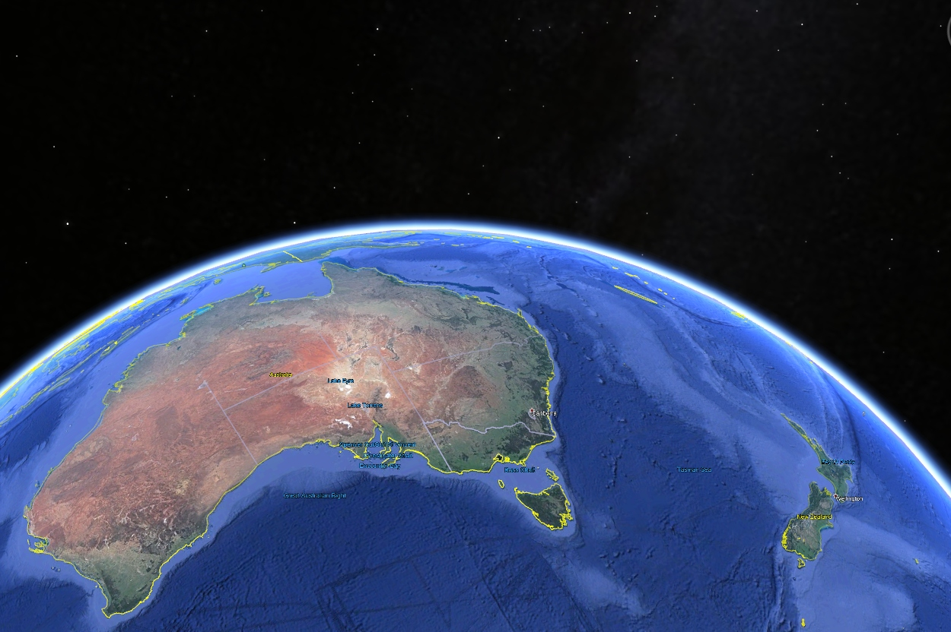
Occultations Down Under
Recent Occultation Happenings in Australia and New Zealand
Steve Kerr
Director – Trans-Tasman Occultation Alliance

Slide 2
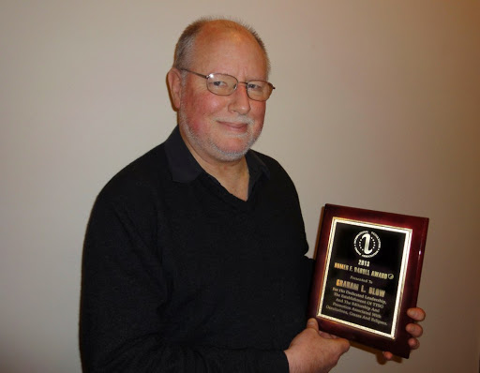
Some History …
Founded and directed by Graham Blow through to December 2014.
Initially formed in Auckland, NZ to try to coordinate occultation observing – grew to cover all of New Zealand.
Became an Observing Section of the Royal Astronomical Society of New Zealand.
Nothing analogous in Australia – so became the coordinating body there too.
Currently looking to ‘rebrand’ the section as the Trans-Tasman Occultation Alliance to better reflect the regional interest.
Graham Blow – 1954-2014

Slide 4
Recent Years Totals
Year | Number of Observers/ Reporters | Reports | Positive Events | Positive Chords Observed
2008 | 26 | 280 | 47 | 66
2009 | 29 | 320 | 46 | 75
2010 | 29 | 343 | 50 | 74
2011 | 28 | 289 | 51 | 70
2012 | 34 | 383 | 51 | 77
2013 | 45 | 532 | 56 | 89
2014 | 35 | 542 | 58 | 76
2015 | 29 | 384* | 45 | 75
2016 | 27 | 475 | 66 | 88
2017 | 21 | 367 | 67 | 97
2018 | 31 | 603 | 114 | 170
2019 | 21 | 743 | 132 | 180
* Likely to be a severe underestimate.

Slide 5
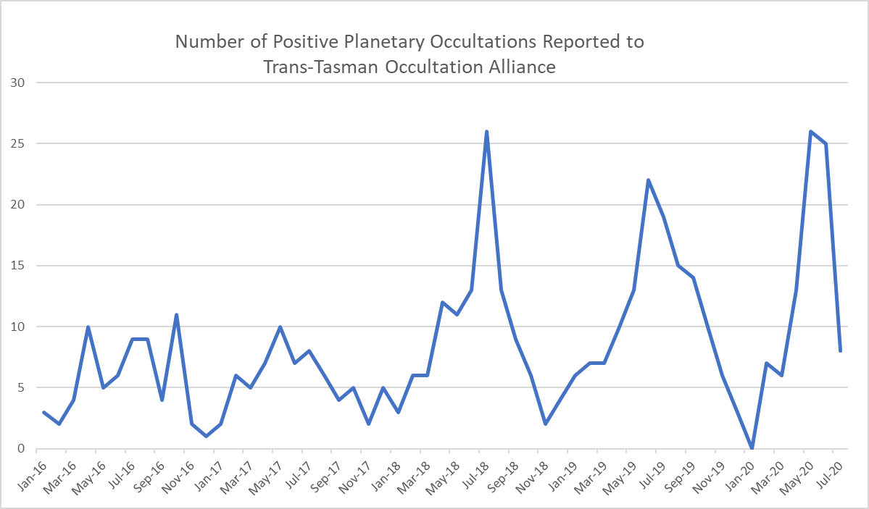

Slide 7
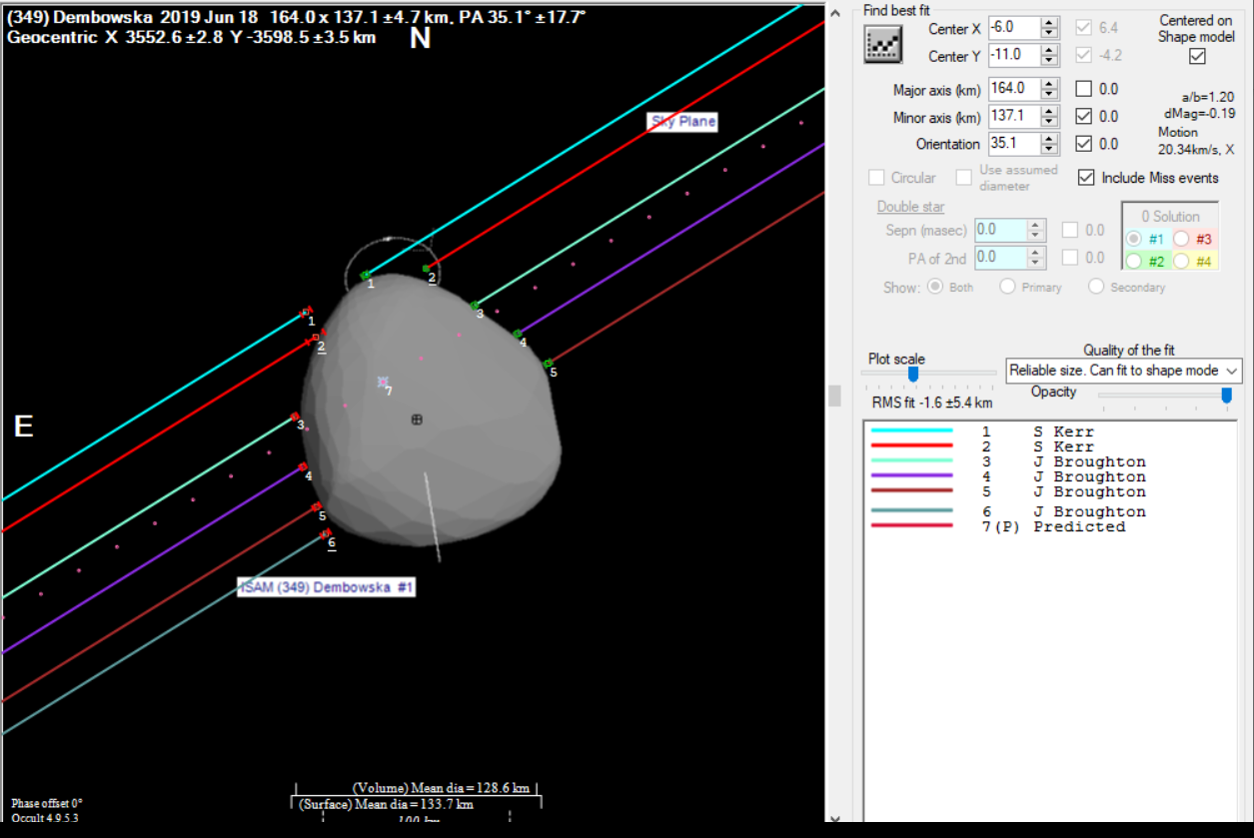

Slide 8
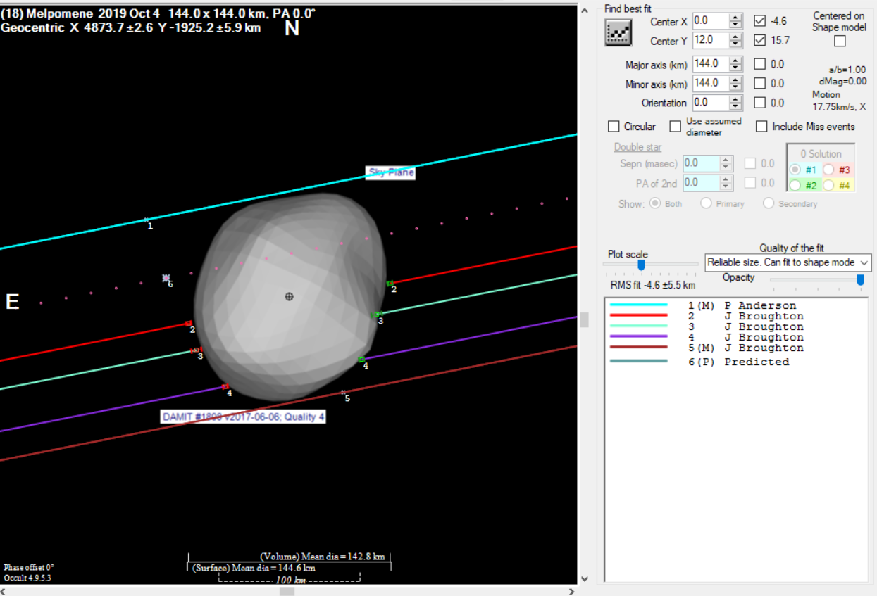

Slide 9
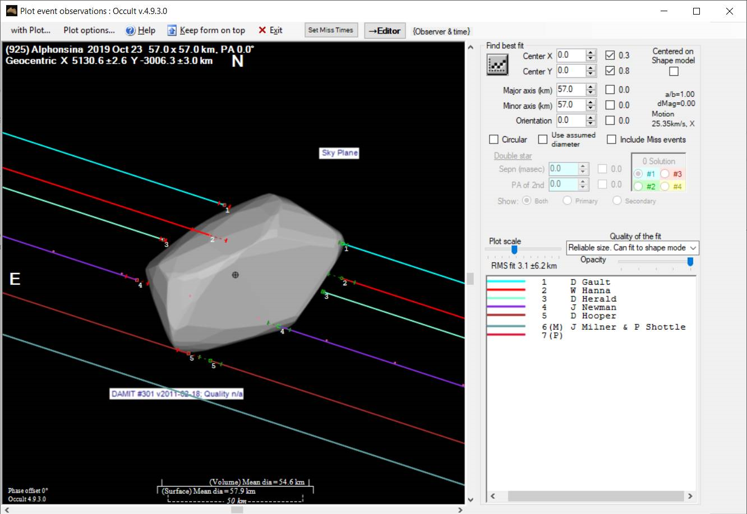

Slide 10
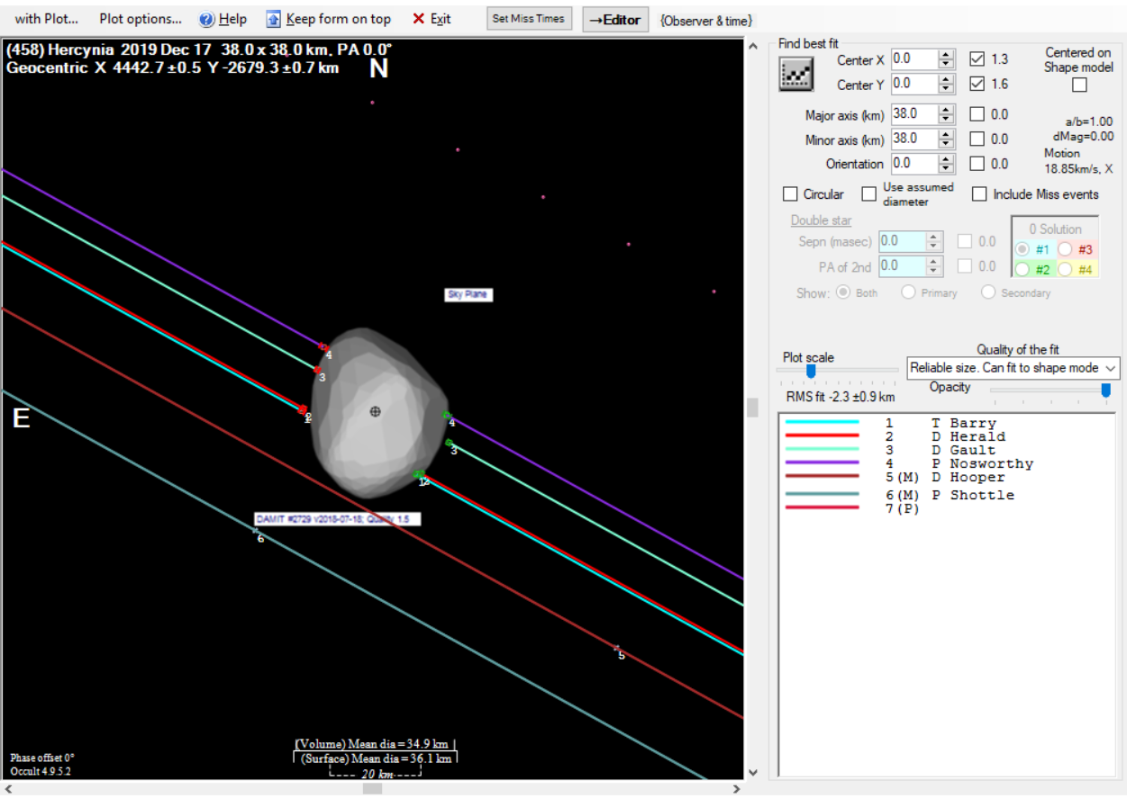

Slide 11
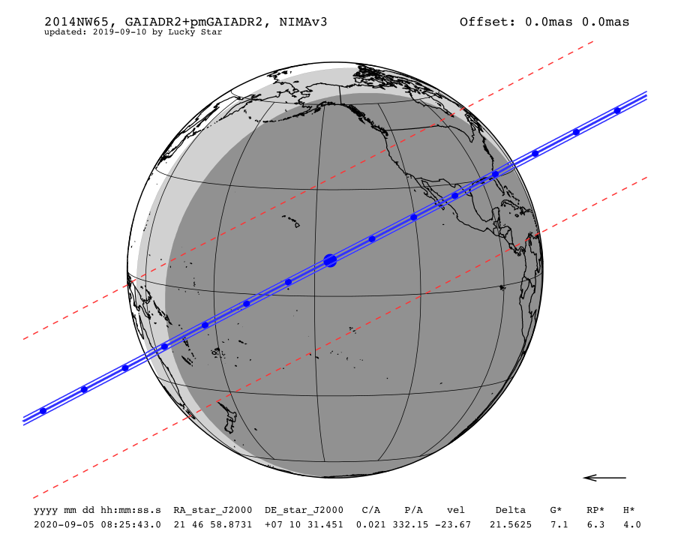
Date | Sat. 5 Sep. 2020 08:25:43
Star position (ICRF) | 21 46 58.8731 +07 10 31.451
C/A | 0.021 arcsec
P/A | 332.15 °
velocity | -23.67 km/s
Geocentric distance Δ | 21.5625 au
G mag* | 7.2
RP mag* | 6.3
H mag* | 4.0
Magnitude drop | 13.2
Uncertainty in time | 152.4 sec
Uncertainty in C/A | 135.8 mas
Uncertainty in projected distance | 2123.4 km
Probability of occultation on centrality | 4.0%
Maximum duration | 9.0 sec
Moon distance to the object | 51.3°
Fraction of illuminated Moon | 91.0 %
Solar elongation | 157.5°

Slide 12
Closing Thoughts
Lunar Occultations – High speed video for studying the star properties
The ‘Gaia Effect’ – far greater numbers of more certain predictions a double edged sword
  Dilutes observer effort
  More chance of finding that special event that covers more fixed observers
  Allows more targeting of specific asteroids and stars
The uptick in the use of Virtual Meetings allowing access to new observers like never before

Slide 13
Thanks
Questions?

